Slide 1
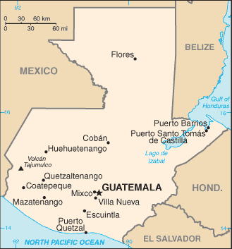
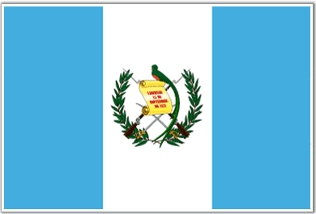
Guatemala
Area: 42, 042 sp. mi
Capital: Guatemala City
population of 2.5 mil.

Slide 2
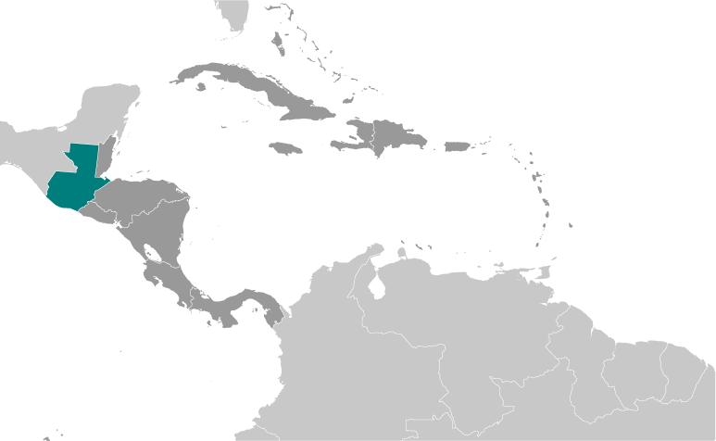
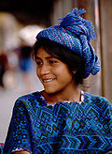
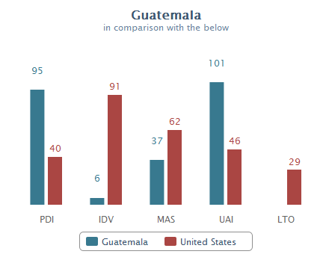
The People of Guatemala
Population: 14.7 mil. (median age: 20)
Indigenous
Less educated, limited access to land, political & legal system, unequal pay, location & language
Mayan revitalization since Peace Accords (‘96) to include: language, dress, religious practice - Rigoberta Menchú (young Mayan woman won Nobel Peace Prize 1992) Largest Maya group: Quiche
Mestizo
Mixed Indigenous & European descent
Wealth, education & family prestige, westernized
Language: Spanish (official) 60%
24 indigenous languages: 40% (remote areas - western highlands, indigenous population, esp. women)
Religion: Protestant – 40%; Catholic – 55%; Mayan
Marginalized groups
Indigenous
Women: Femicide (targeting of women because
of the their gender) >600 killed last year
*50% of the population engages in some form of
agriculture, often at the subsistence level outside
the monetized economy
* 49% of the population living in urban areas

Slide 3
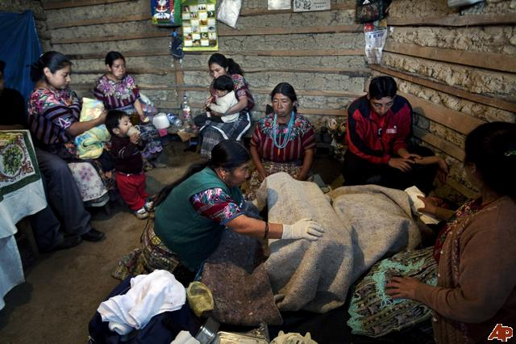
Summary Statistics (2011 est):
GDP: $27.5B, (78/183)
Per Capita: $4,965, (116/181)
growth: 3% (120/183)
Salary Workforce:
42% services
37% industry/commerce
14% agriculture
Export: $8.5B - 38.5% to US
Import: $13.8B – 37% US
Top remittance (2/3 of exports)
CAFTA, $686 foreign investment
coffee, bananas, sugar, crude oil, chemical products, clothing and textiles, vegetables

Slide 4
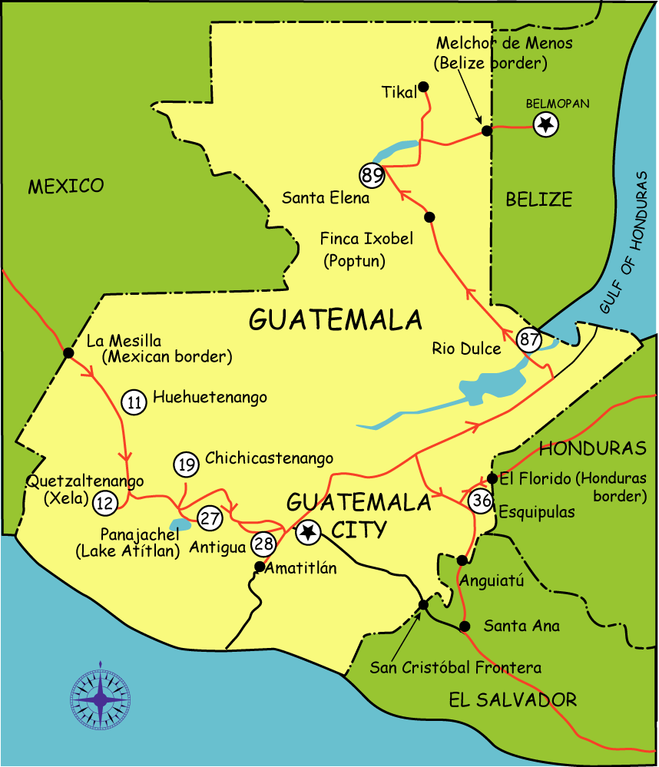
Infrastructure
Education:
6 year compulsory (free),
41% attendance (2/3 primary, 1/5 secondary),
74% literacy (136/183)
Healthcare:
70.88 life expectancy, (113/191)
38 infant mortality, (125/194)
poor rural access, malnutrition (70%)
Transportation:
14,000 km roads, 6,000 paved,
shut down railroad

Slide 5
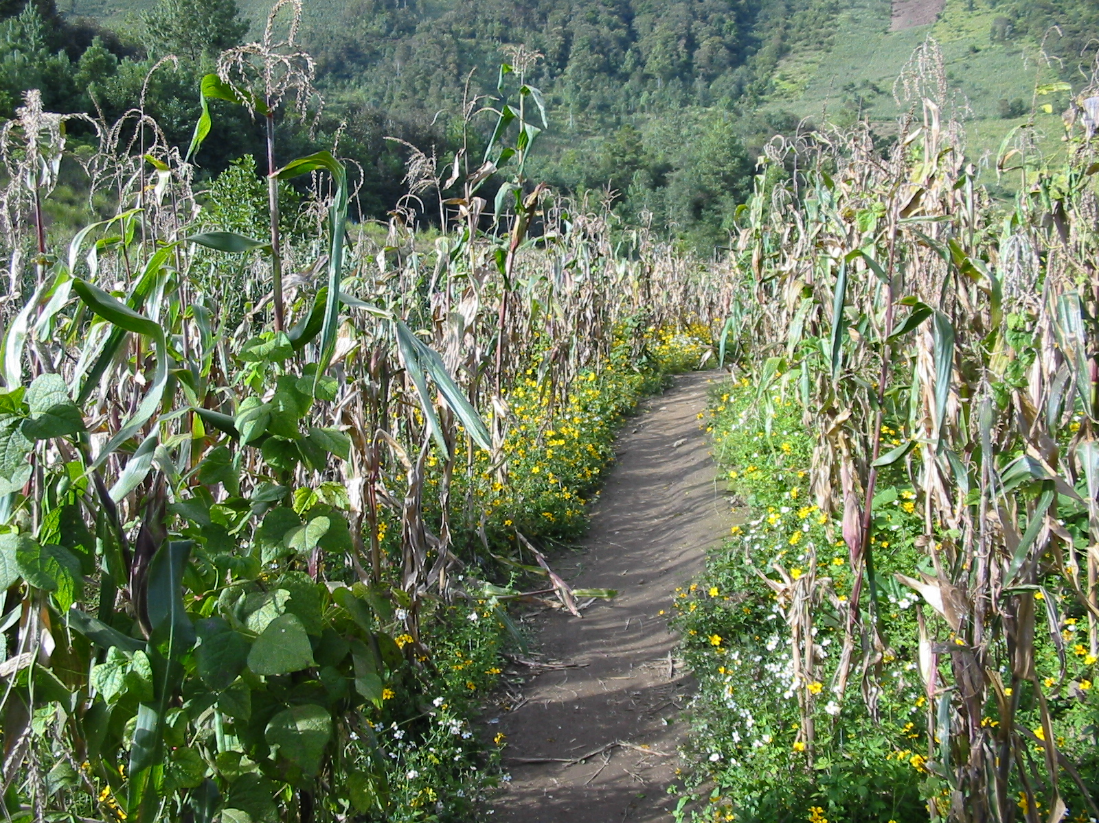
Agriculture (1998 Data)
Production:
15.5MT sugar cane
200KT coffee
733KT bananas
1.1MT corn
Subsistence agriculture Milpas (forest clearing)
17.5% land (of 75%) used
23% GDP, 75% exports
50% of population engages in some form of agriculture
Nontraditional agriculture trend

Slide 6
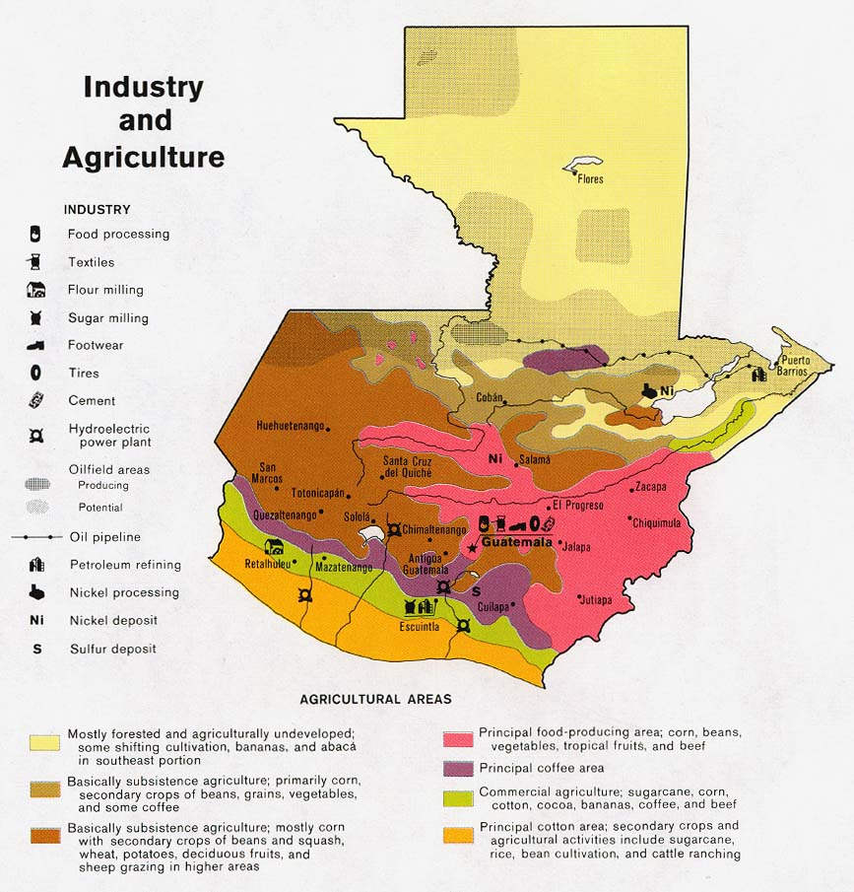

Slide 7
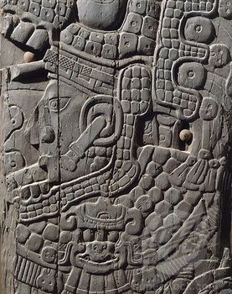
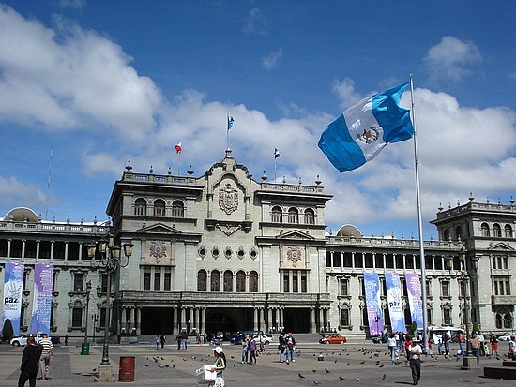
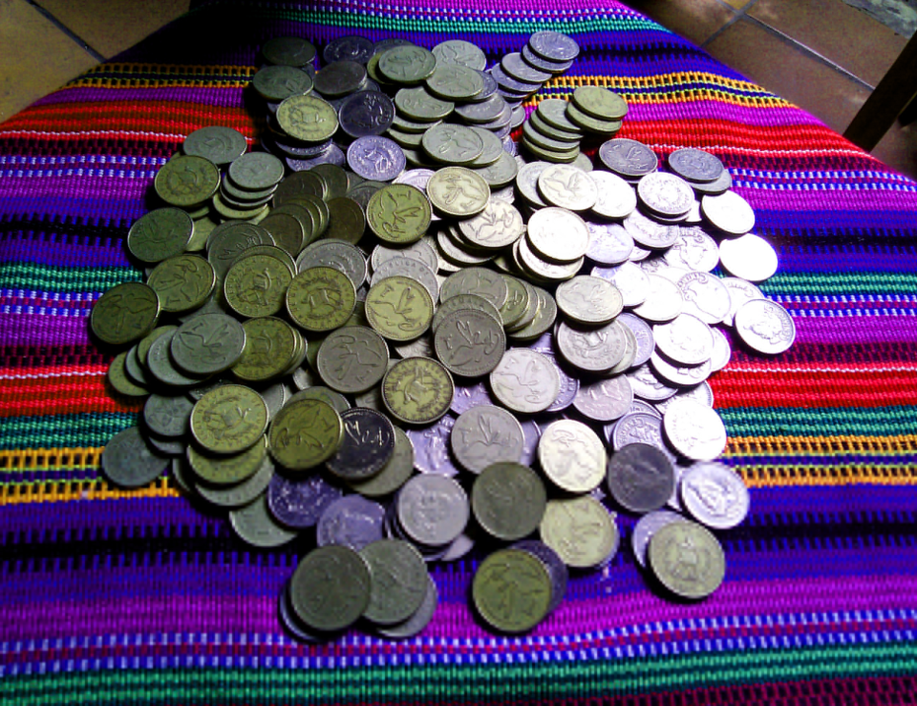
Guatemala’s History
1820: Independence from Spain
1840: Becomes sovereign state
1944-1954: Social-democratic reforms under Arevalo yield various educational, economic and land rights for peasants
Legalization of the communist party and nationalization of plantations of the United Fruit Company

Slide 8
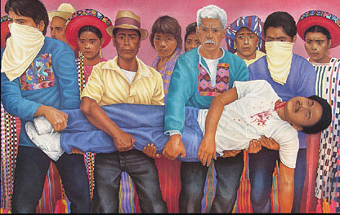
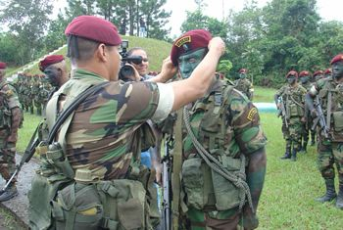
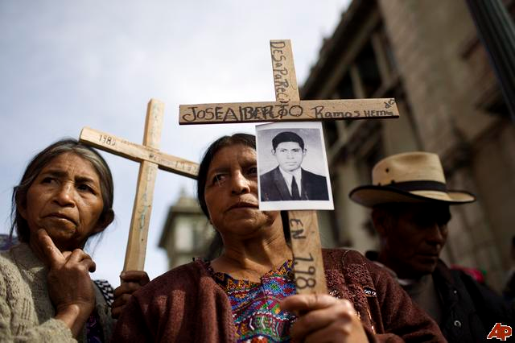
Civil War
1960: Civil War begins, fueled by U.S.-backed coup in 1954
1970-1983: violence between the Guatemalan army and leftist guerillas leads to country’s worst era of human rights violations.
1970: State of siege declared under Arana; decade of military-controlled government
1982: General Rios Montt unleashes a particularly brutal counterinsurgency against left-wing guerillas
1986: new constitution and democratic transition begins
December 1996: Peace Accords signed
Sources: Crisis Group, U.N.-backed Commission for Historical Clarification “Guatemala: Memory of Silence, Inter-American
Notes:
Civil War: government-backed militias terrorize the civilian population, counter-insurgency; disappearances of labor leaders, politicians and students, torture, murder. Guerilla leaders follow Cuban revolution model and take base in countryside, subsequently becoming areas most affected by violence.
With Cold War as backdrop, Eisenhower approves CIA operations to supply weapons and funding for paramilitaries setting up the coup of 1954. Over the next three and a half decades, the US trained and equipped Guatemalan Army to battle the guerrillas in bloody counter-insurgency campaigns, often operating in cooperation with paramilitary groups organized into Civil Self-Defense Patrols or Patrullas de Autodefensa Civil (PACs). Some paramilitary groups acted as death squads in both rural and urban areas, terrorizing those associated with leftist or opposition activities.
An estimated 200,000 to 300,000 people died over the course of the conflict.

Slide 9
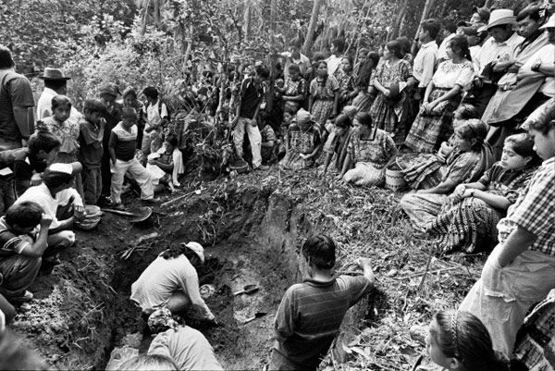
Legacy of Violence
More than 200,000
killed, hundreds of
thousands flee the
country and are
internally displaced.
83% of victims are
indigenous, 93% of
human rights
violations by state
forces
Exhumation at Comalapa, a former Army base.

Slide 10
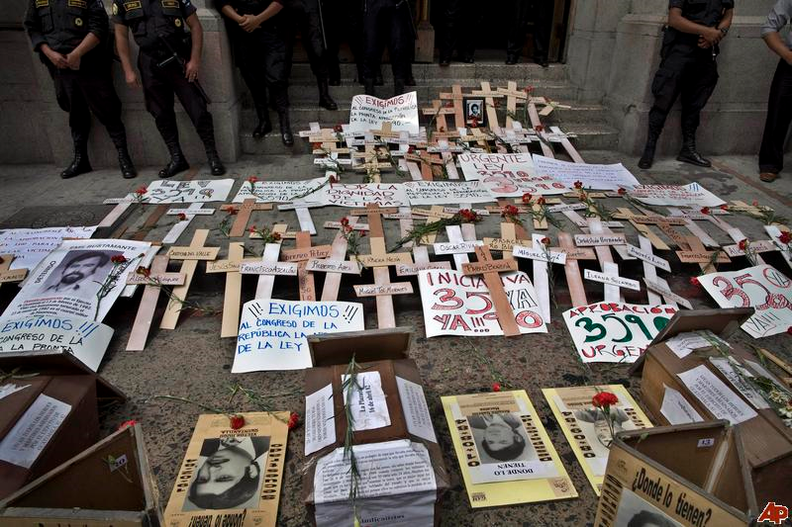
Peace Accords: 1996-1997
Civil War
Peace Accords
Aftermath
1993
1994
1996
Church led development of constitutional reform
Presidential Leadership
2007 - Alvaro Colom: National Unity of Hope Party (center/left). Accused of assassination of prominent lawyer.
2011 – Former general Otto Perez Molina elected (Patriotic Party)
Peace talks began in under new Human Rights Ombudsperson Ramiro de Leon
Reached agreements on human and indigenous rights and resettlement
Alvaro Arzu elected: purged military of current leaders and signed peace agreement with URNG
- Military rapidly reduced – 10,000 troops retired.
UN Involvement:
UN Security Council Resolution 1094 – military observers sent to Guatemala
UN Involvement:
International Commission Against Impunity in Guatemala – CICIG acts in conjunction with national prosecutors
Notes:
Murder rate remains high, 97% of cases go unsolved. Illegal armed groups continue to attack government, judicial and civilian people and institutions. Femicide continues (700+ murders of women in 2008).
Transparency international rating of 2.7 (bad).
Freedom House-current state of civil and political rights on a scale from 1 (most free) to 7 (least free)-rating of “partly free,” a decline this year.
New President:
Former general near the end of the civil war. Accused of involvement in a couple murders and disappearances, including an activist bishop.

Slide 11
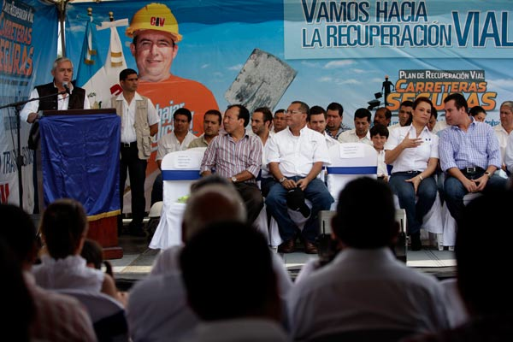
Government Structure
Constitutional Democratic Republic
Separation of powers
Centralized national administration
1985 Constitution
President: one 4-yr term; universal suffrage
Unicameral Congress: 158 members; 4-yr terms
Supreme Court of Justice: 13 members; 5-yr terms; elected by Congress
Oligarchy
Coffee barons, corporate executives, gov’t officials
333 municipalities; 9 major political parties
2007 voting reform legislation
doubled polling places in rural areas
Provision of Social Services
Link between Military & Gov’t

Slide 12
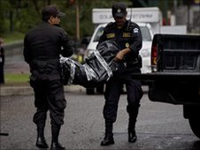
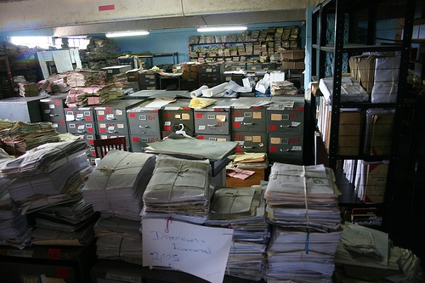
Framework for the Rule of Law
Accountability Challenges
Extent of Violent Crime & Impunity
Former state security apparatus → illicit networks
97% homicides unsolved
2007: UN official, “Guatemala is a good place to commit a murder because you will almost certainly get away with it.”
Block investigation; destroy evidence; frame scapegoat; kill judiciary members; fabrication of evidence
Transparency International Rate: 2.7
Enforcement
Judiciary independent, but plagued by inefficiency, corruption, intimidation → limited ability to cope with violent crime
Recent Attempts at Legal Reform
2005 Inspection of National Police Archive
2008 International Commission Against Impunity in Guatemala (CICIG)
Composed of international investigators, administrators, security personnel
Controversial cases and investigations
Extended through Sept. 2013

Slide 13
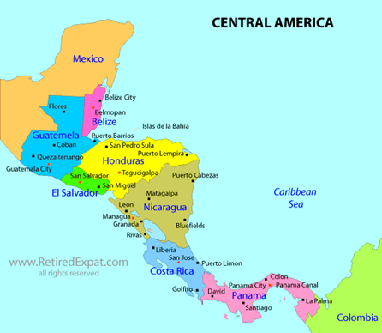
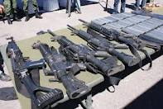
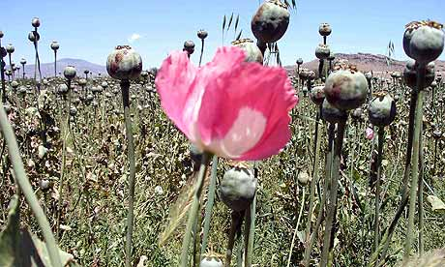
Growth of Organized Crime, Drug Trade
Guatemala lies midway between US and Columbia
Control of drug trade from Columbia to Mexico in late 1990’s
Drug crackdown in 2006 that forced cartels to move contraband over land
An impoverished, underemployed population is a ready source for recruits
Financing of opium poppy cultivation provide indigenous communities with large $
In last decade, homicide rate has doubled to more than 40 per 100,000
Last Year - 52 per 100,000 with 108 per 100,000 in Guatemala City (Mexico is 18 per 100,000)
Source: Guatemala: Drug Trafficking and Violence; International Crisis Group; October 2011 and Los Angeles Times

Slide 14
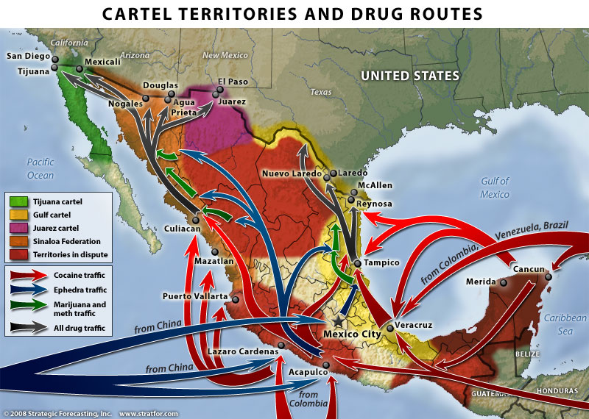
Key Facts of Drug Trade
2008
Nearly 400 metric tons of cocaine—75% of the total amount arriving in the US—pass through Guatemala each year.
Cocaine passing through Guatemala brings in approximately $7 billion in US sales each year.
40% of the 6,200 murders in 2008 in Guatemala were deemed related to drug trafficking.
Experts estimate that 60 percent of the country’s territory is controlled by drug traffickers.
Drug Cartels Operating in Guatemala: Gulf Cartel – traffics cocaine, marijuana, meth, and heroin
Into the US (Los Zetas is the enforcement branch); Sinaloa Cartel - smuggles Columbian cocaine
through Guatemala by joining with the Herrera organization; 13 other smaller organization
Struggling for control
Source: Guatemala: Guatemala Human Rights Commission 2008

Slide 15
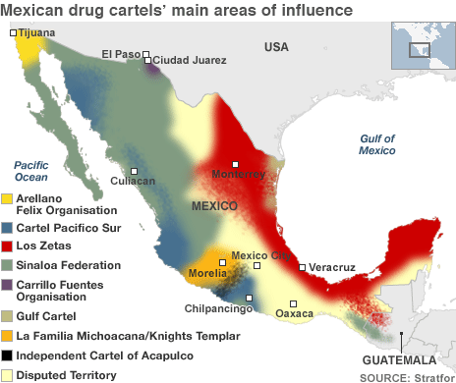
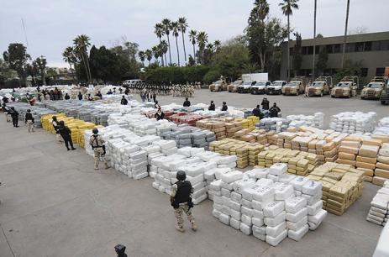
Mexican Drug Cartels – The Rise of Los Zetas
Pushing to gain control from more peaceful Guatemalan drug mafia
More than 500 in Guatemala – most are nationals
Compete w/ local traffickers associated with Sinaloa and Gulf Cartels
Founded by 30 deserters from Mexican Special Forces in 1999, including Heriberto Lazcano, now leader of Zetas
Started as enforcement wing of the Gulf Cartel
Ossiel Cardenas Guillen, leader of the Gulf, arrested in 2010
Source: Guatemala: Drug Trafficking and Violence; International Crisis Group; October 2011 and “Guatemala and the Face of the New Sustainable Narco-State,” Vanderbilt
University, October 2010

Slide 16
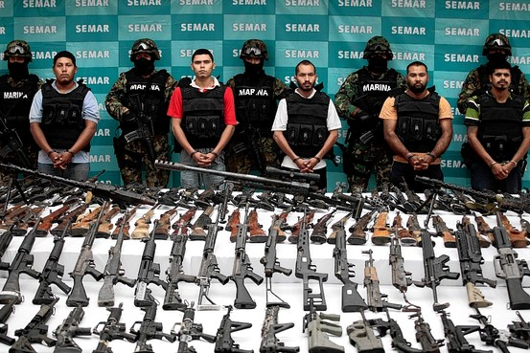
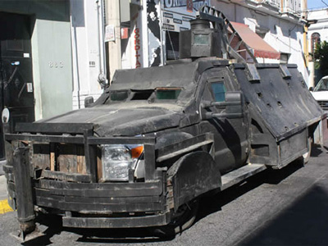
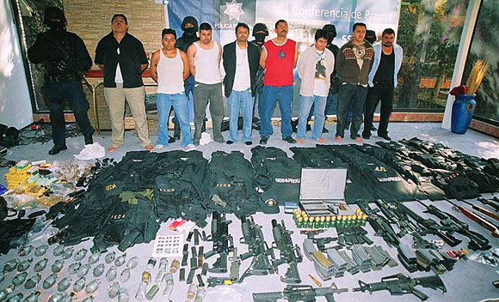
Small Arms in Guatemala
Rate of private gun ownership – 13.1 per 100 (49/179)
Total guns 1,650,000; unlawfully held 1,600,000
Defense forces: 148,770 firearms
38.52 per 100,000 rate of gun homicide
Permits to carry concealed weapons are available to both citizens and tourists
Only licensed security companies and the government can lawfully carry automatic weapons
Source: GunPolicy.org

Slide 17
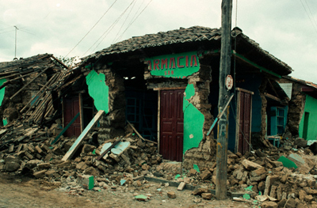
Challenges
Marginalized interior: infrastructure
Social services worst in Central Am.
Natural disasters: 3 hurricanes
Wealth imbalance:
52% < $2/day,
15% < $1/day,
highest Central Am.
Competition from Asia in manufacturing
Manufacturing mostly in Guatemala city
Underdeveloped transportation

Slide 18
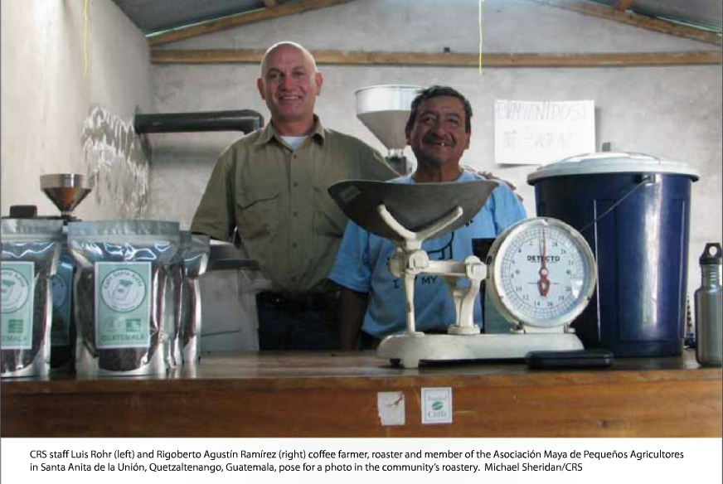
CRS Guatemala
CRS Guatemala – Food Security Program
-Zacapa lies along Guatemala’s “Corredor Seco,” presenting a series of nutritional challenges
-Infant mortality and malnutrition are among the highest in the region
-Environmental landscape: prone to natural disasters, impact of climate change
→Focus on improved agricultural productivity and sustainable use of natural resources

Slide 19
Assignment
Zacapa is a region representative of Guatemala’s national challenges
Hunger, violence, and distrust of local and national government
Given constraints on CRS as a local partner, how can bananas become a viable option for generating income for farmers in Cooperativa Todos Hermanos?
Notes:
Challenge group to think about what the constraints are – want them looking at constraints that go beyond resources: social? principles? CRS has many.

Slide 20
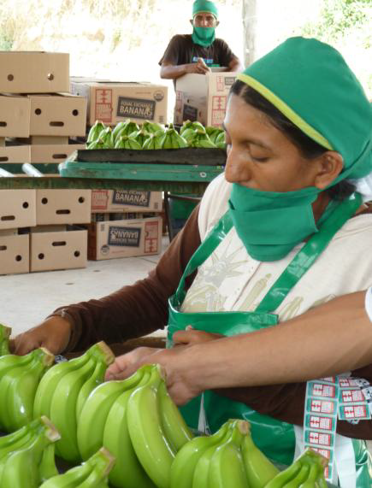
Life of a Banana
Global Banana Market
100b consumed annually
4th largest agricultural product
3 major MNCs control ~66% market
U.S. market price
Liberal trade; CAFTA
Consumed within ~30 days of harvesting
Harvested and stored ~58 degrees, transported
Flowers produce bunches, hands, fingers (~3 mo)
Stalks produce flower clusters (~9 mo)
Stems sprout and form multiple stalks
Under-ground rootstalks produce stems
Notes:
Teaching notes should encourage further research into the export/value chain of the banana, complexities thereof.

